Slide 1

Plagiarism and citation
Presented by:
Ahmed Raza (2521352)
Hamza Hafeez (2521344)
Umme Habiba (2521313)
Zeenat Yousaf (2521336)

Slide 2
Outlines
What is plagiarism?
Types of plagiarism
How to avoid plagiarism
Penalties of plagiarism
Golden rule of plagiarism
Citation
Why should I cite a source?
Why I need to cite a source?
Relation between plagiarism and citation
conclusion

Slide 3

What is plagiarism?
“The practice of taking someone else's work or ideas and passing them off as one's own.”
Plagiarism means using someone else’s work without giving them proper credit. In academic writing, plagiarizing involves using words, ideas, or information from a source without citing it correctly. In practice, this can mean a few different things.

Slide 4

Types of plagiarism
These seven types of plagiarism are the most common:
Complete plagiarism.
Direct plagiarism.
Paraphrasing plagiarism.
Self-plagiarism.
Patchwork plagiarism.
Source-based plagiarism.
Accidental plagiarism.

Slide 5

How to avoid plagiarism
Keeping track of the sources you consult in your research.
Commit to doing your own work.
Give credit where credit is due.
Beware of cutting and pasting.
Paraphrase with care.
Use a plagiarism checker before you submit.

Slide 6

Penalties Of Plagiarism
Low grades
Failing in course
Academic suspension
Monetary Repercussions
Expulsion

Slide 7

Golden Rule Of Plagiarism
Be honest
Give credit where credit is due

Slide 8
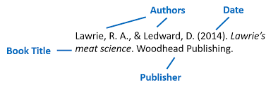
Citation
A "citation" is the way you tell your readers that certain material in your work came from another source.

Slide 9
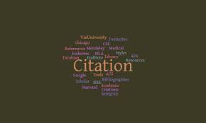
Why should you cite sources?
To give credit to the source authors
To help your audience/reader find out more about your research/arguments/ideas/topic
To strengthen your work by providing outside support to your ideas
citing sources shows the amount of researches you have done

Slide 10

Why do you need to cite a source?
Whenever you use quotes
Whenever you paraphrase
Whenever you use an idea that someone else has already expressed
Whenever you make specific reference to the work of another
Whenever someone else's work has been critical in developing your own ideas.

Slide 11
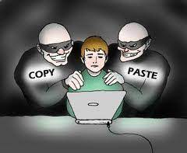

Plagiarism vs. citation
The term “plagiarism” comes from a Greek word that means “kidnapping.” It is the term used to identify the intentional appropriation or stealing of ideas from others.
Citation, on the other hand, is the term we give to the act of attributing ideas that are not our own to their sources.

Slide 12

Conclusion
Plagiarism is a problem that can be glaring or subtle, but it is always serious; avoid it!
Knowing what plagiarism is and how to detect it in writing can help you to avoid it in your writing
Familiarity with a standard citation style and forcing yourself to stick with can help you:
- organize your sources in your research notes
- organize your sources for your reader
- Avoid plagiarism in your writing

Slide 13

Any question

Slide 14
Thank you!

